Slide 1
n BRIGHTLINE
DISCIPLINED AI. REAL MARKETS. BRIGHTER OUTCOMES.
Autonomous Options Trading Agent
Alpaca AI Trading Agents Hackathon × lablab.ai — Options Alpha Track — Team AAF11
Prateek D Shriyan · Rafan Ahamad Sheik

Slide 2
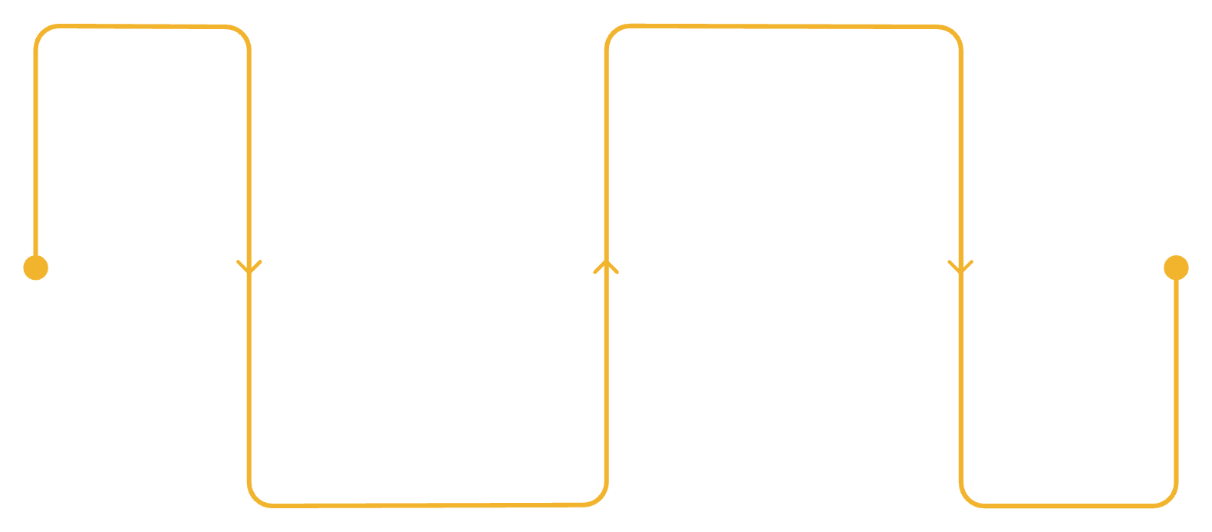



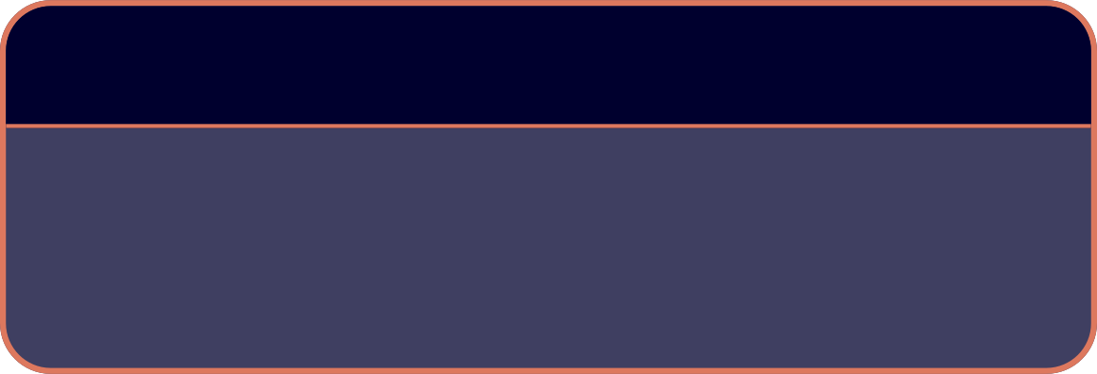

THE PROBLEM
AI CAN TRADE. BUT WHO CONTROLS THE TRADE?
When an AI model reasons directly to the broker, every reasoning failure becomes a live financial risk. The gap between a model's output and a disciplined execution layer is where most AI trading systems break down.
DANGEROUS
ENGINEERED
Broker executes
Immediate trades with no guardrails
AI reasons
Broker Executes
Model outputs trade decisions
AI Reasons
Rules Verify
Risk Controls
1
2
3
HALLUCINATION
CONSTRAINT FAILURE
RISK FAILURE
Model may quote or invent information never supplied to it in the context window.
Model can misunderstand or silently ignore deterministic trading constraints.
Position sizing must never depend on probabilistic language-model reasoning.
AI should reason about the market. It should not control the boundaries of the system.

Slide 3





BRIGHTLINE
MARKET DATA IN. DISCIPLINED ACTION OUT.
An autonomous options-trading agent engineered to separate AI reasoning from deterministic trading authority. Every component has a single, auditable responsibility.
Market Data
Quant Signals
AI Reasoning
Rulebook
Risk Gate
Core Capabilities
Trading Universe
SPY
QQQ
IWM
REAL DATA
REAL SIGNALS
Live prices + option chains via Alpaca Market Data API
P(Up), IV Rank, VRP, Market Regime, Days to Earnings
DIA
Four liquid ETF underlyings. Broad-market coverage with deep option chains and tight spreads.
REAL AGENTS
REAL EXECUTION
AI proposes. Python decides. Risk controls the boundary.
Groq (LIVE) + Featherless (SHADOW) + Mistral (SHADOW)
Alpaca CLI + atomic MLEG order construction

Slide 4
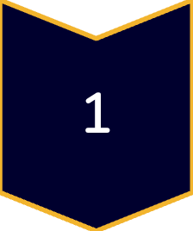


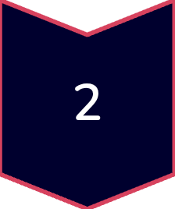

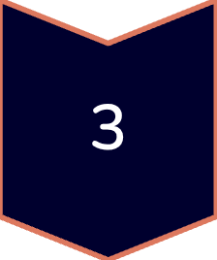

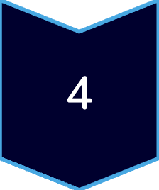

ARCHITECTURE
ONE PIPELINE. THREE MODELS. ONE EXECUTION PATH.
System Flow
AI Model Roles
Key Principle
SCHEDULER + MARKET DATA
GROQ — LIVE
All three models receive the identical signal vector. Shadow models never touch the execution path.
Alpaca data feed ingested every 15 minutes
Primary execution model. Can submit orders. Subject to all safety and rulebook checks.
SIGNAL ENGINE
P(Up) · IV Rank · VRP · Regime · Days to Earnings
FEATHERLESS — SHADOW
Reasons and compares. Records agreement with Groq. Never executes.
3 AI MODELS IN PARALLEL
Same signal vector → Groq, Featherless, Mistral
MISTRAL — SHADOW
SAFETY + DECISION LAYER
Independent shadow reasoning. Cross-model comparison for divergence logging.
Deterministic rulebook · Risk gate · Broker reconciliation
ALPACA CLI → ATOMIC MLEG → AUDIT LOG
One controlled execution path. Fully logged.

Slide 5
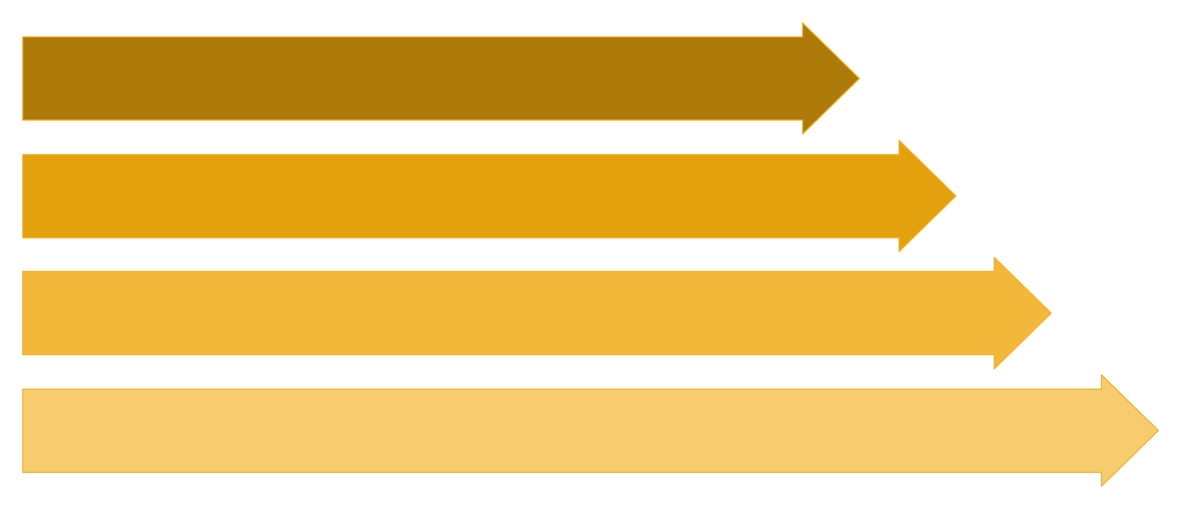
AI + SAFETY
AI PROPOSES. THE SYSTEM VERIFIES.
Five independent stages can stop a trade. Only one controlled, audited path can start one.
Signal Vector
Parallel Models
Verification Layer
Rulebook Decision
Safety Guards
The Rulebook Principle
1
SIGNAL VALIDATION
The rulebook is re-derived in Python directly from raw signals — not from the model's summary or paraphrase of those signals.
Rejects invalid, missing, NaN, or internally inconsistent signal inputs before any model sees them.
This architectural choice eliminates an entire category of hallucination risk. The model's reasoning is advisory. The Python logic is authoritative.
2
FAITHFULNESS CHECK
Five independent stages can stop a trade. Only one controlled path can start one.
Verifies whether figures quoted by the model were actually supplied in the prompt context.
3
CROSS-MODEL COMPARISON
Records agreement and divergence across Groq, Featherless, and Mistral outputs for every cycle.
4
BROKER RECONCILIATION
Independently reads live broker state before execution — never trusts in-memory assumptions.

Slide 6
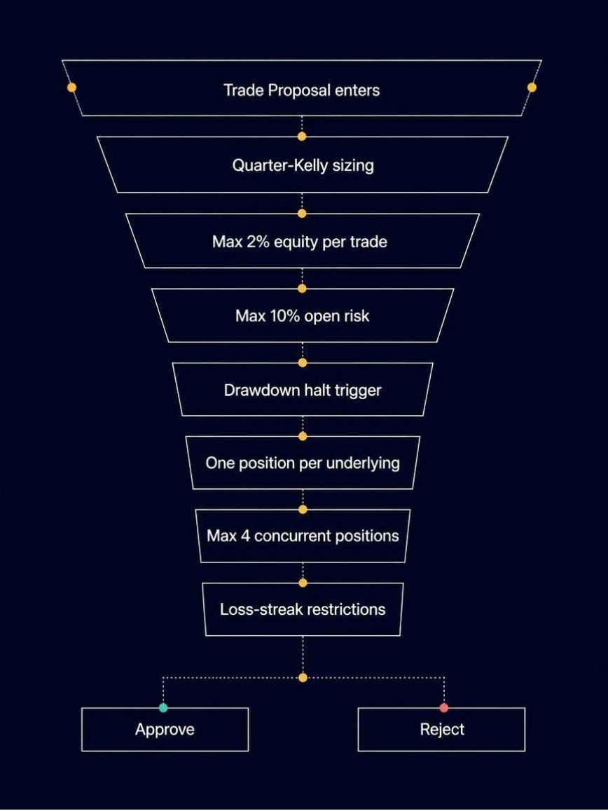

RISK ENGINE
RISK IS NOT AN AI DECISION.
Every constraint in the risk engine is deterministic, coded in Python, and runs independently of any model output. The AI cannot override, negotiate, or bypass any limit.
Risk Funnel
A Failure We Caught Before Execution
Hard Limits Summary
This is an engineering validation case, not a performance claim. It demonstrates that the deterministic risk layer functions as designed.
≤ 2%
equity per trade
Initial Calculation
Corrected Calculation
~$16,000 open risk computed
⛔ REJECTED by Risk Gate
$2,034 max risk · 1.98% of equity · 12 contracts
✅ APPROVED by Risk Gate
≤ 10%
total open risk
The deterministic risk layer caught an incorrect open-risk calculation before execution reached the broker. This is engineering validation — not a profitability proof.
≤ 4
concurrent positions
1
position per underlying

Slide 7
EXECUTION + VALIDATION
FROM SIGNAL TO ORDER. WITHOUT A HUMAN IN THE LOOP.
Automated Trigger
Market Data
Signal Gen
Model Decisions
Autonomous Boundary
Validation Metrics
AUTONOMOUS
Engineering validation benchmarks — not performance or profitability claims.
Market data ingestion · Signal generation · AI reasoning · Rulebook evaluation · Risk gate · Order execution · Audit logging
203+
HUMAN BOUNDARY
Credentials provisioning · Kill switch activation
Autonomous Cycles
Execution Details
Completed end-to-end without manual intervention
Every 15 Minutes
Primary Scheduler
Backup
153
during market hours
cron-job.org
GitHub Actions
Tests Passed
Execution
Across signal, safety, rulebook, and risk layers
Alpaca CLI subprocess
4
Underlyings
SPY, QQQ, IWM, DIA
3
AI Models
Groq, Featherless, Mistral

Slide 8
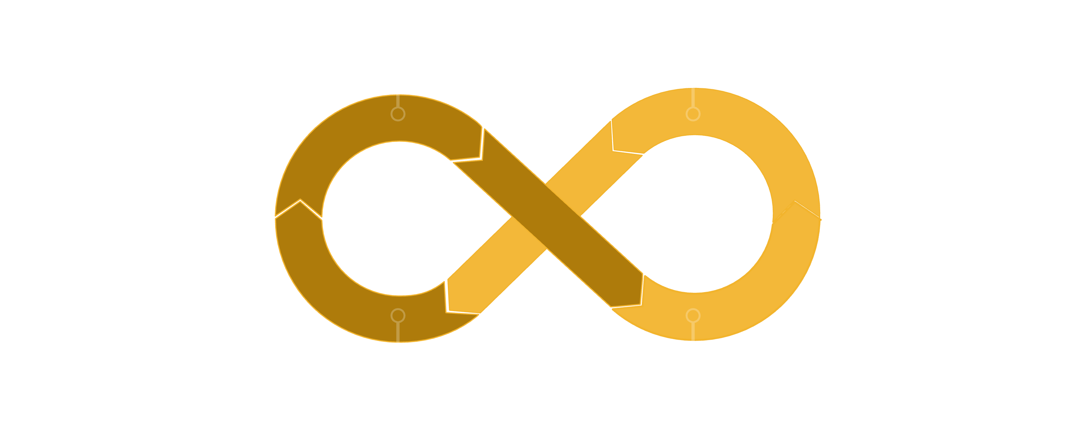



THE BIG PICTURE
SAME MARKETS. SMARTER AGENTS.
Sense
Reason
Control Risk
Verify
What Building It Taught Us
The Founding Principle
The Classifier Problem
The IV Rank Problem
The Model Frequency Problem
INSTRUMENTATION > ASSUMPTIONS
The bullish branch never fired. P(Up) did not cross the rulebook threshold. A system without instrumentation would never have surfaced this.
The premium-selling branch required sufficient price history before IV Rank became meaningful. Assumptions about data readiness are always wrong.
A model queried every 15 minutes with daily-resolution data produced constant predictions. Frequency mismatch is a silent, invisible failure mode.
Every failure above was invisible until we built the logging, cross-model comparison, and signal validation layers to surface it. The system's reliability comes from its observability.
LET AI REASON ABOUT THE MARKET.
NEVER LET THE MODEL DECIDE WHAT THE SYSTEM IS ALLOWED TO DO.
BRIGHTLINE · Alpaca AI Trading Agents Hackathon · Options Alpha Track · Team AAF11

